Slide 1
OCCUPATIONAL SAFETY AND HEALTH LAW FOUNDATION IN INDONESIA
TEAM TEACHING OF OSH
JURUSAN TEKNOLOGI INFORMASI
POLITEKNIK NEGERI MALANG

Slide 2
Review
What is the law that forms the basis of K3 in Indonesia?
More important health or safety?
In the IT field, where are the most common OHS applications?
What does the gear in the osh symbol mean?
What does the green color in the osh symbol mean?

Slide 3
Why Work Accidents Occur?
Unsafe act?
Unsafe condition ?
Work environment ?
Weak management control?
….

Slide 4

OSH Issue
NEED SMK3
Occupational Health Issues
On-site health disorders work, including:
Lung disease.
Bone muscle injury.
Cancer.
Hearing loss due to noisy.
Occupational diseases.
OSH Problems
No system.
Lack of work standards.
Less concerned about K3 issues.
Still using the old paradigm.
Work Safety Issues
Work-related accidents, including:
The high number of work accidents.
Fire hazard.
Traffic accident to and from work.

Slide 5
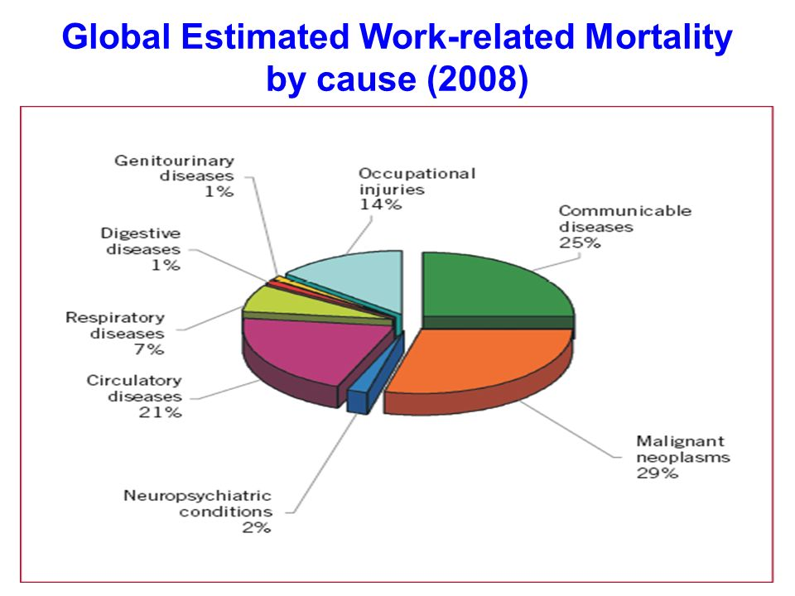
Why is OSH law important?
Global:
2,3 million deaths from occupational accidents and work-related diseases each year
5,850 fatal work accidents are reported every day
Indonesia (2002-2005):
More than 300,000 job accidents
5000 deaths
500 permanent disabilities
Compensation of more than IDR 550 billion

Slide 6
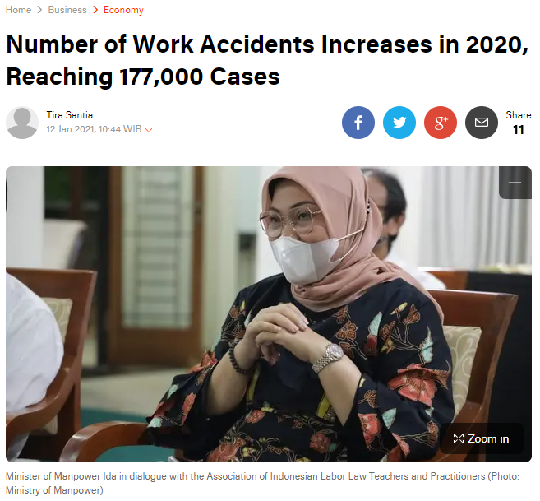
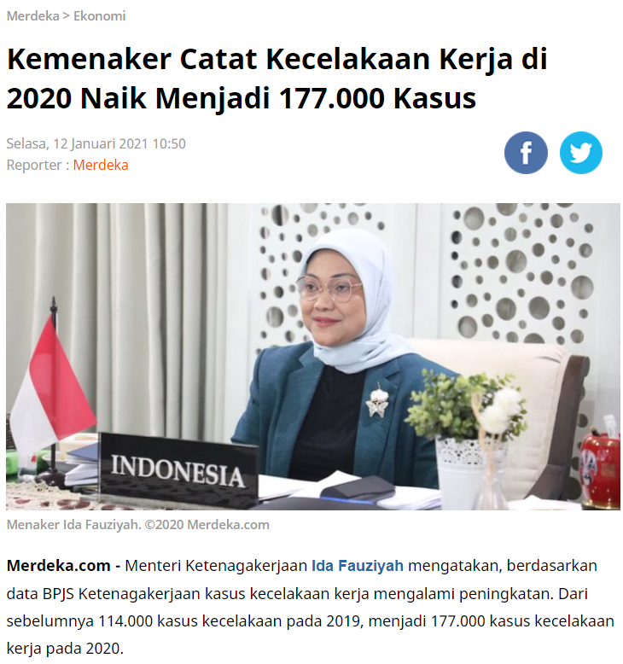
Why is OSH law important?

Slide 7
Backgrounds
One of the efforts in overcoming accidents and occupational disease in the workplace is implementation of laws and regulations, among others through:
There are OSH terms and conditions that always follow developments in science, engineering and technology.
The application of all OSH terms and conditions is appropriate with the laws and regulations in force since the manipulation.
Supervision and monitoring of the implementation of OSH through workplace inspections.

Slide 8

OSH Law Foundation in Indonesia
Article 27 paragraph (2) of the 1945 Constitution:
"Every citizen has the right to work and a livelihood that is decent for humanity"”.
Law No. 14 of 1969:
Article 9 → "Every workforce is entitled to protection by security".
Article 10 (a) → “The government builds work safety norms”.

Slide 9
OSH Law in Indonesia
Looking at the target, there are 2 groups of occupational safety legislation:
Legislative groups aim to preventing work-related accidents.
→ Law No. 1 of 1970
Legislative groups that aim to compensate for accidents that have already occurred.
→ Work-related Accident Law (1947-1957) and its derivatives

Slide 10
UU NO. 1 OF 1970
Published to replace the Veiligheids Reglement (VR) in 1910 (promulgated in State Gazette No. 406 of 1910).
Issued because the old regulations were unable to deal with industrial developments involving the use of mechanical and electrical machines, installations, and raw materials.
The old regulation contained repressive oversight so that it was not suitable for implementation in an independent country.
The purpose of this law is to provide protection for the safety of workers and other people who enter the work area, and to ensure that production sources are used safely and efficiently.

Slide 11
UU NO. 1 OF 1970
Workers’ Rights
Ask the management to carry out all the mandatory occupational safety and health requirements.
Expressing work objections to jobs where the requirements for occupational safety and health as well as the required personal protective equipment are questionable by him.

Slide 12
UU NO. 1 OF 1970
Workers’ Obligations
Provide correct information when requested by supervisory staff and / or work safety experts.
Wear the required personal protective equipment.
Fulfill and comply with the required occupational safety and health requirements

Slide 13
UU NO. 1 OF 1970
Business’s Owner Obligation
Carry out the requirements for work safety, as described in Article 3 paragraph (1).
Conduct health checks on workers who will be accepted or will be transferred, and conduct periodic health checks for workers.
Demonstrate and explain to each new worker the conditions and hazards in the workplace, all safeguards and protective equipment in the workplace, and safe ways to carry out their work.

Slide 14
UU NO. 1 OF 1970
Business’s Owner Obligations
The Minister of Manpower has the authority to form an Occupational Safety and Health Committee (P2K3).
Managers are required to report every accident that occurs in the workplace.
Managers are required to post all required work safety drawings and all other guidance materials in the workplaces they lead and provide the required personal protective equipment to workers.

Slide 15
Work-Related Accident Law (1947-1951)
This law was promulgated in 1947 and entered into force in 1951.
Contains compensation rules for workers who have an accident or illness due to work.
Some important points from the Accident Law, include:
Employers are obliged to pay compensation to workers who have a work accident.
Diseases arising from work relations are seen as accidents.
If a worker dies due to a work accident, the obligation to pay is imposed on the family that is left behind.

Slide 16
Work-Related Accident Law (1947-1951)
This law defines the types of companies that are obliged to provide compensation.
This law defines the conditions for a person to be called a worker and non-laborer.
Doctors, advisors, and supervisory employees are appointed, whose positions are also determined.
This law determines the types of compensation that must be provided.
The company is obliged to provide benefits to workers who due to an accident are temporarily unable to work, permanently unable to work partially, permanently disabled, or permanently unable to work again.

Slide 17
Work-Related Accident Law (1947-1951)
This law explains the amount of allowance for the family of workers who die.
The things that cause the company not to be obliged to pay losses are also described in this law.
The employer or management is obliged to report an accident that occurs no more than 2x24 hours after the accident.

Slide 18
UU NO. 23 OF 1992
This law regulates the implementation of JAMSOSTEK (Social Security for Workers) which is managed by an insurance mechanism. (since 2014, JAMSOSTEK was replaced by BPJS Ketenagakerjaan)
The scope of JAMSOSTEK in this law, among others:
Accident insurance
Life insurance
Pension plan
Health care insurance
Work Accident Security Contribution, Death Security Fee, and The health care insurance contribution is borne by the entrepreneur. Old age savings contributions are borne by employers and workers.

Slide 19
UU NO. 24 OF 2011
Law No. 24 of 2011 regulates the formation of the Social Security Administration (BPJS), including BPJS Ketenagakerjaan
The scope of BPJS Ketenagakerjaan, includes:
Accident insurance
Life insurance
Pension plan
Pension Guarantee
Employers (in this case employers or managers) are required to collect contributions that are borne by participants from BPJS Ketenagakerjaan from their employees and deposit them to BPJS.

Slide 20
UU NO. 50 OF 2012
Law No. 50 of 2012 regulates concerning Implementation of Occupational Health and Safety Management System.
Every company is required to implement SMK3 in their company. The obligations as referred to in paragraph (1) apply to companies:
employs at least 100 (one hundred) workers/laborers; or
has a high level of potential danger.

Slide 21
Other Law that regulate OSH
PP No. 88 of 2019 concerning work safety.
Presidential Decree No. 7 of 2019 concerning Occupational Diseases
Presidential Decree No. 34 of 2014 concerning Ratification of the Convention Concerning The Promotional Framework For Occupational Safety and Health / convention 187, 2006 (Convention Concerning the Framework for Improving Occupational Safety and Health / convention 187, 2006)
Regulations on occupational safety and health are more specifically regulated through Ministerial Regulation.

Slide 22
List Of Law that regulate OSH
The 1945 Constitution Article 27 Paragraph 2 concerning a decent living
Law No. 1 of 1970 concerning Occupational Safety
Law No. 13 of 2003 concerning Manpower
Regulation of the Minister of Manpower and Transmigration No. PER.03/MEN/1982 concerning Labor Health Services
Regulation of the Minister of Manpower of the Republic of Indonesia NUMBER: PER.04/MEN/1987 concerning the Committee for the Development of Occupational Safety and Health (P2K3)

Slide 23
List Of Law that regulate OSH
Regulation of the Minister of Manpower No. NUMBER : PER-02/MEN/1992 concerning Procedures for Appointment, Obligations and Authorities of Occupational Safety and Health Experts
Regulation of the Minister of Manpower Number Per-04/MEN/1995 concerning Occupational Safety and Health Service Companies
Decree of the Minister of Manpower and Transmigration of the Republic of Indonesia NUMBER: KEP.239/MEN/2003. regarding Guidelines for Implementing Competency Certification for Candidates for Occupational Health and Health Experts
OSH Month Award for Permenakertrans companies NUMBER: PER – 01/MEN/I/2007 About Occupational Safety and Health Award for Companies.
Government Regulation Number 50 of 2012 concerning Implementation of Occupational Health and Safety Management System

Slide 24
Task :
Work in group consist of 3 students.
Based on the presentation above, each group choose one law, highlight or make it in one pages, make it eye-catching and easy to understand or remember by make it as instagram stories :D
You may publish your ‘insta story’ next week while you are presenting to your friend. Next week we will have a nice discussion about OSH Law.
You can use Canva as a tool to arrange the material and to design your task

